Slide 1

Python
by:
Dr. Muhammad Aqib
University Institute of Information Technology
PMAS-Arid Agriculture University Rawalpindi

Slide 2
Contents
Variables in Python
Working with Operators
Math Expressions in Python
Concatenation of Text Strings
Conditional Statements
How to Reach Me?

Slide 3
Variables in Python
Variables are containers for storing data values.
Python has no command for declaring a variable.
A variable is created the moment you first assign a value to it.

Slide 4
Variables in Python (cont.)
Variables do not need to be declared with any particular type, and can even change type after they have been set.
x = 4 # x is of type int x = “Allah" # x is now of type str print(x)

Slide 5
Variables in Python (cont.)
Things to remember while naming a Python variable
A variable cannot be enclosed in quotation marks.
There should not be any space(s) in it.
It can't be a number or begin with a number.
In addition, a variable can't be any of Python's reserved words, also known as keywords—the special words that act as programming instructions, like print.

Slide 6
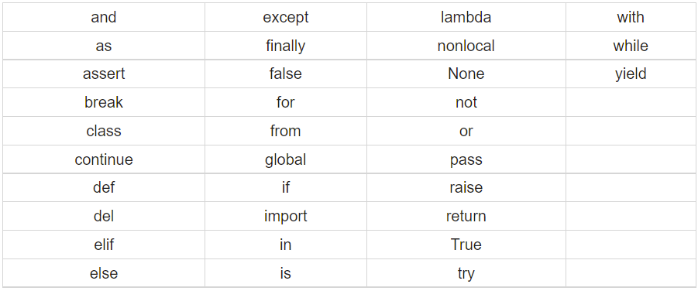
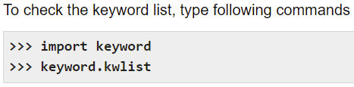
Variables in Python (cont.)
List of python reserved words.
Tutorialspoint.com

Slide 7
Variables in Python (cont.)
In case of using a reserved word as a variable name, Python will generate a syntax error but will not specify that it's a variable-naming error.
A variable name can contain only lowercase letters, uppercase letters, numbers, and underscores.
Variable names are case-sensitive.
Better to break-up multi-word variables with underscores.

Slide 8
Working with Operators
remainder =10 % 3
count = count + 1
count += 1
count = count – 1
count -= 1
count = 10
Increment = 5
count += increment

Slide 9
Math Expressions in Python
Python uses by precedence rules in mathematical expressions. As we have read about “BODMAS”.
Don’t get confused by complex precedence rules. Use parentheses to eliminate ambiguity.
Parentheses override all the other precedence rules. They force Python to complete operations enclosed by parentheses before completing any other operations.
2 * 4 + 6 / 3 – 1 * 5

Slide 10
Concatenation of Text Strings
name = “Muhammad” + “ “ + “Aqib”
first_name = “Muhammad”
last_name = “Aqib”
name = first_name + “ “ + last_name
space = “ “
name = first_name + space + last_name
name = first_name + space + last_name + “\n”

Slide 11
Concatenation of Text Strings (cont.)
age = 20
print(“His age is: “ + age)
Went wrong??
Check this out!!
Print(“His age is:”, age)

Slide 12
Conditional Statements
How to write an “if” statement
if age == 20:
print(“He is a teenager”)
if is a keyword where both “i” and “f” are in lowercase.
“==“ is a comparison operator.
“==“ is not equivalent to “=“
After “if” statement, you tell what to do if the statement is true.
Block of code after “if” statement should be indented by one tab.

Slide 13
Conditional Statements (cont.)
Comparison Operators
== represents “is equal to”
!= represents “is not equal to”
> represents “is greater than”
>= represents “is greater than or equal to”
< represents “is less than”
<= represents “is less than or equal to”

Slide 14
Conditional Statements (cont.)
How to use “else” and “elif” statements
if marks == 40:
print(“You are marginally pass”)
elif marks < 40:
print(“Fail”)
else:
Print(“Pass”)

Slide 15
Thank You

